Slide 1


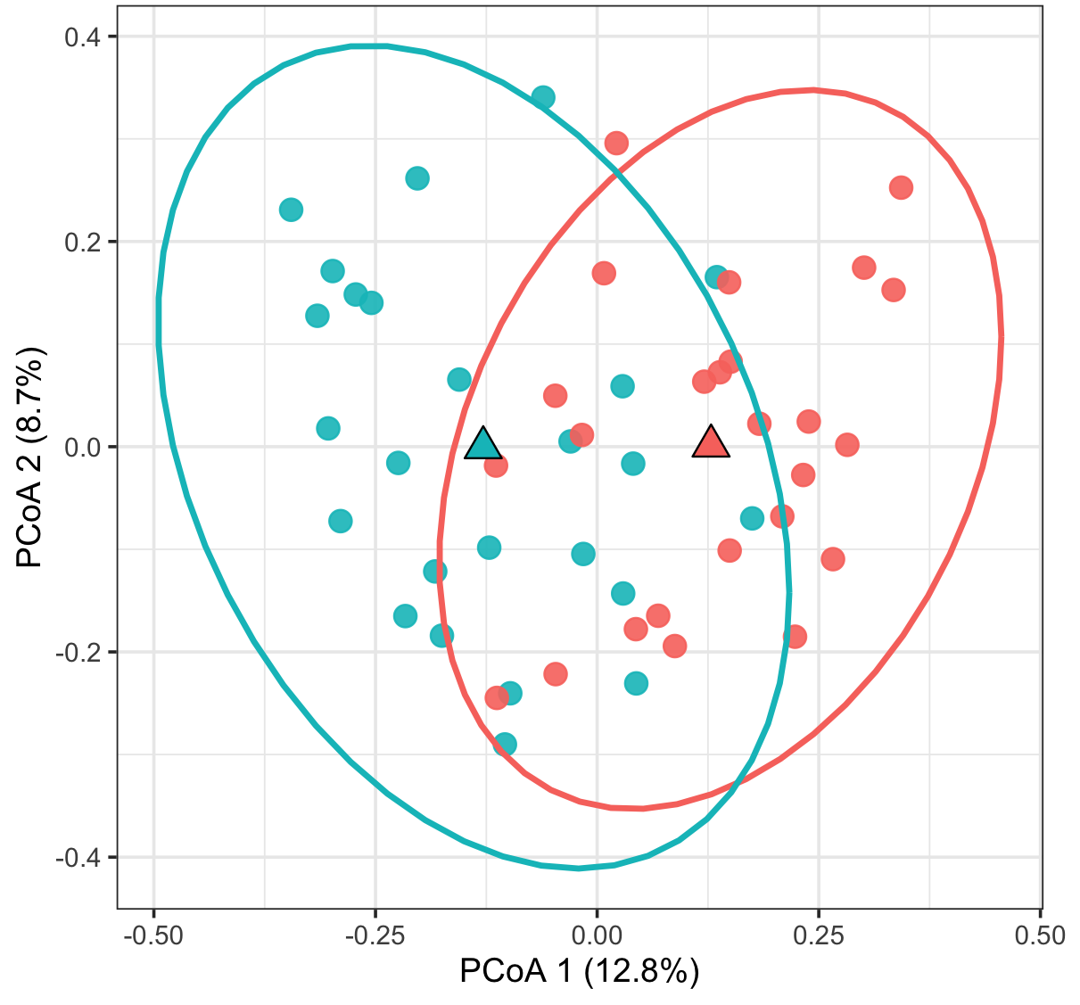
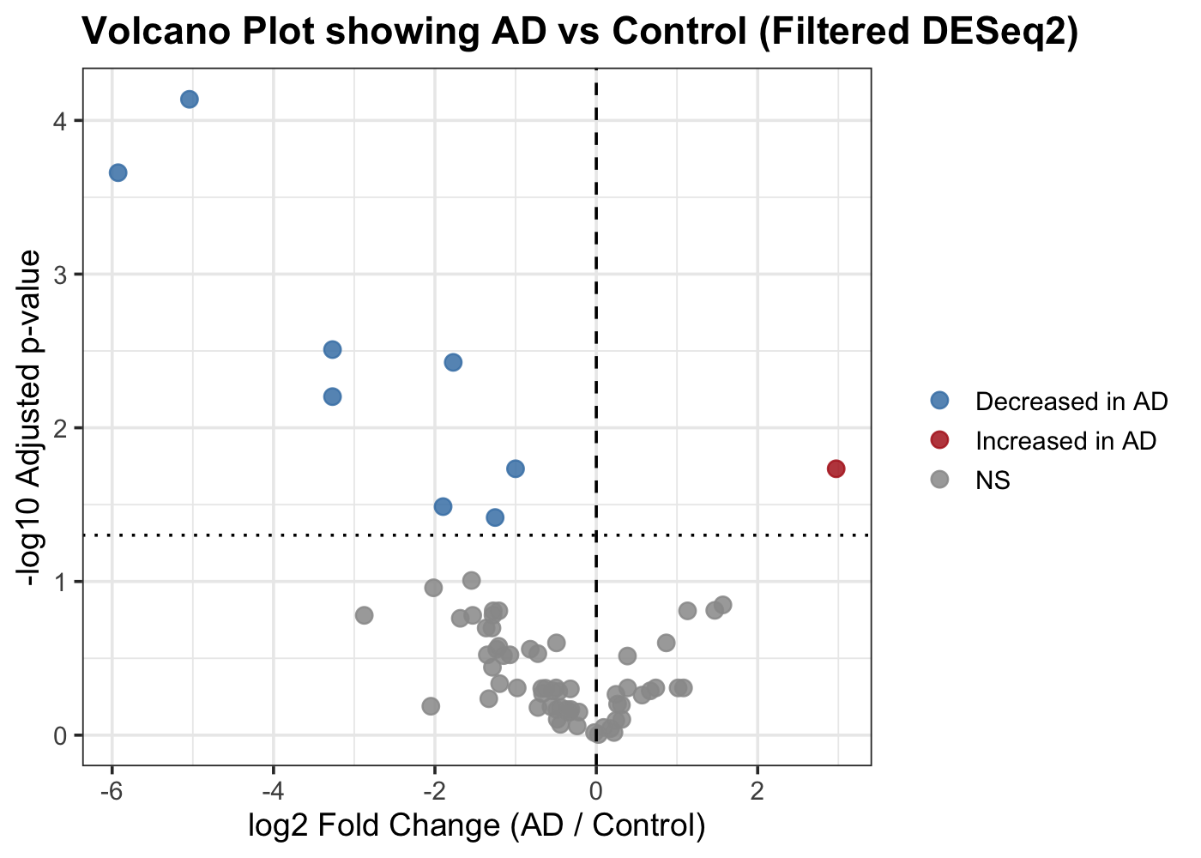
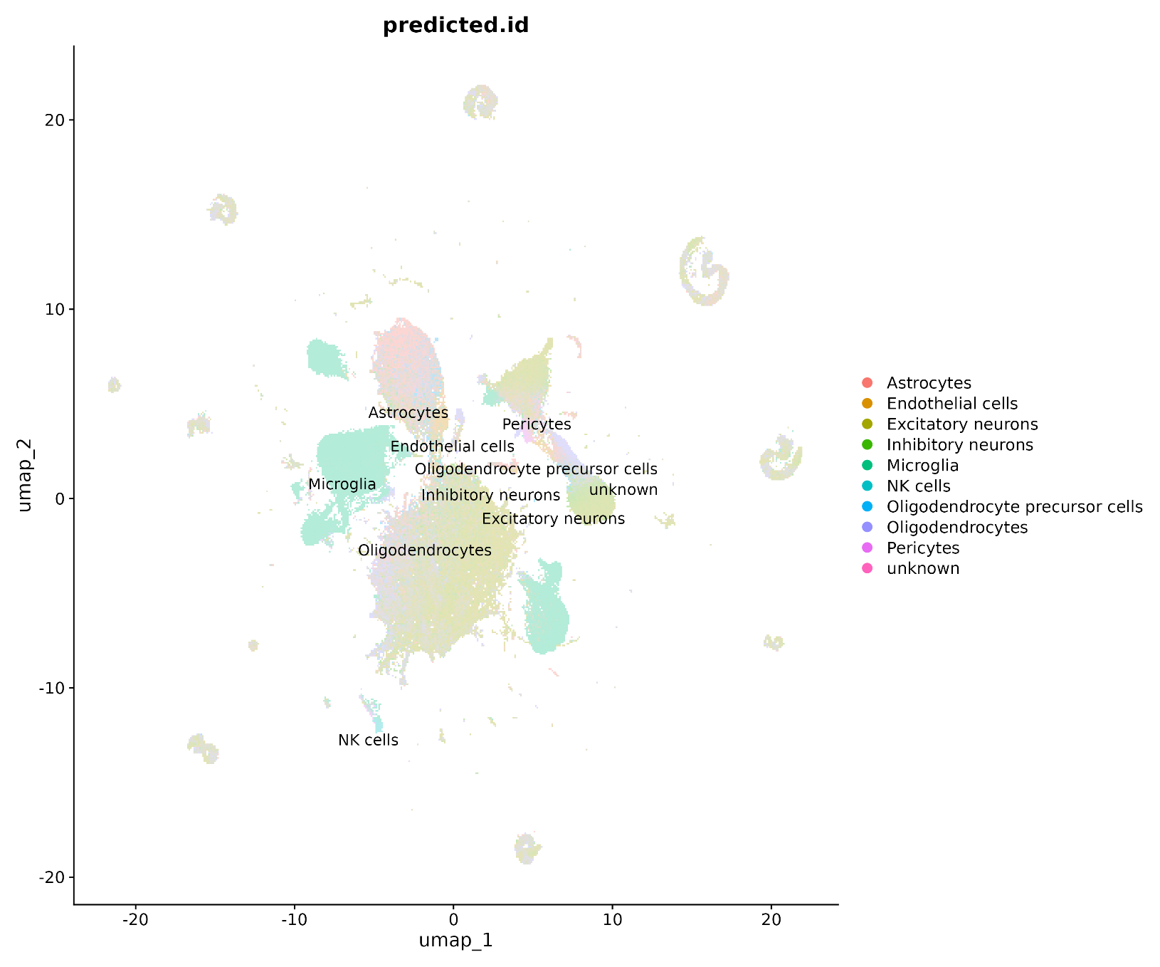
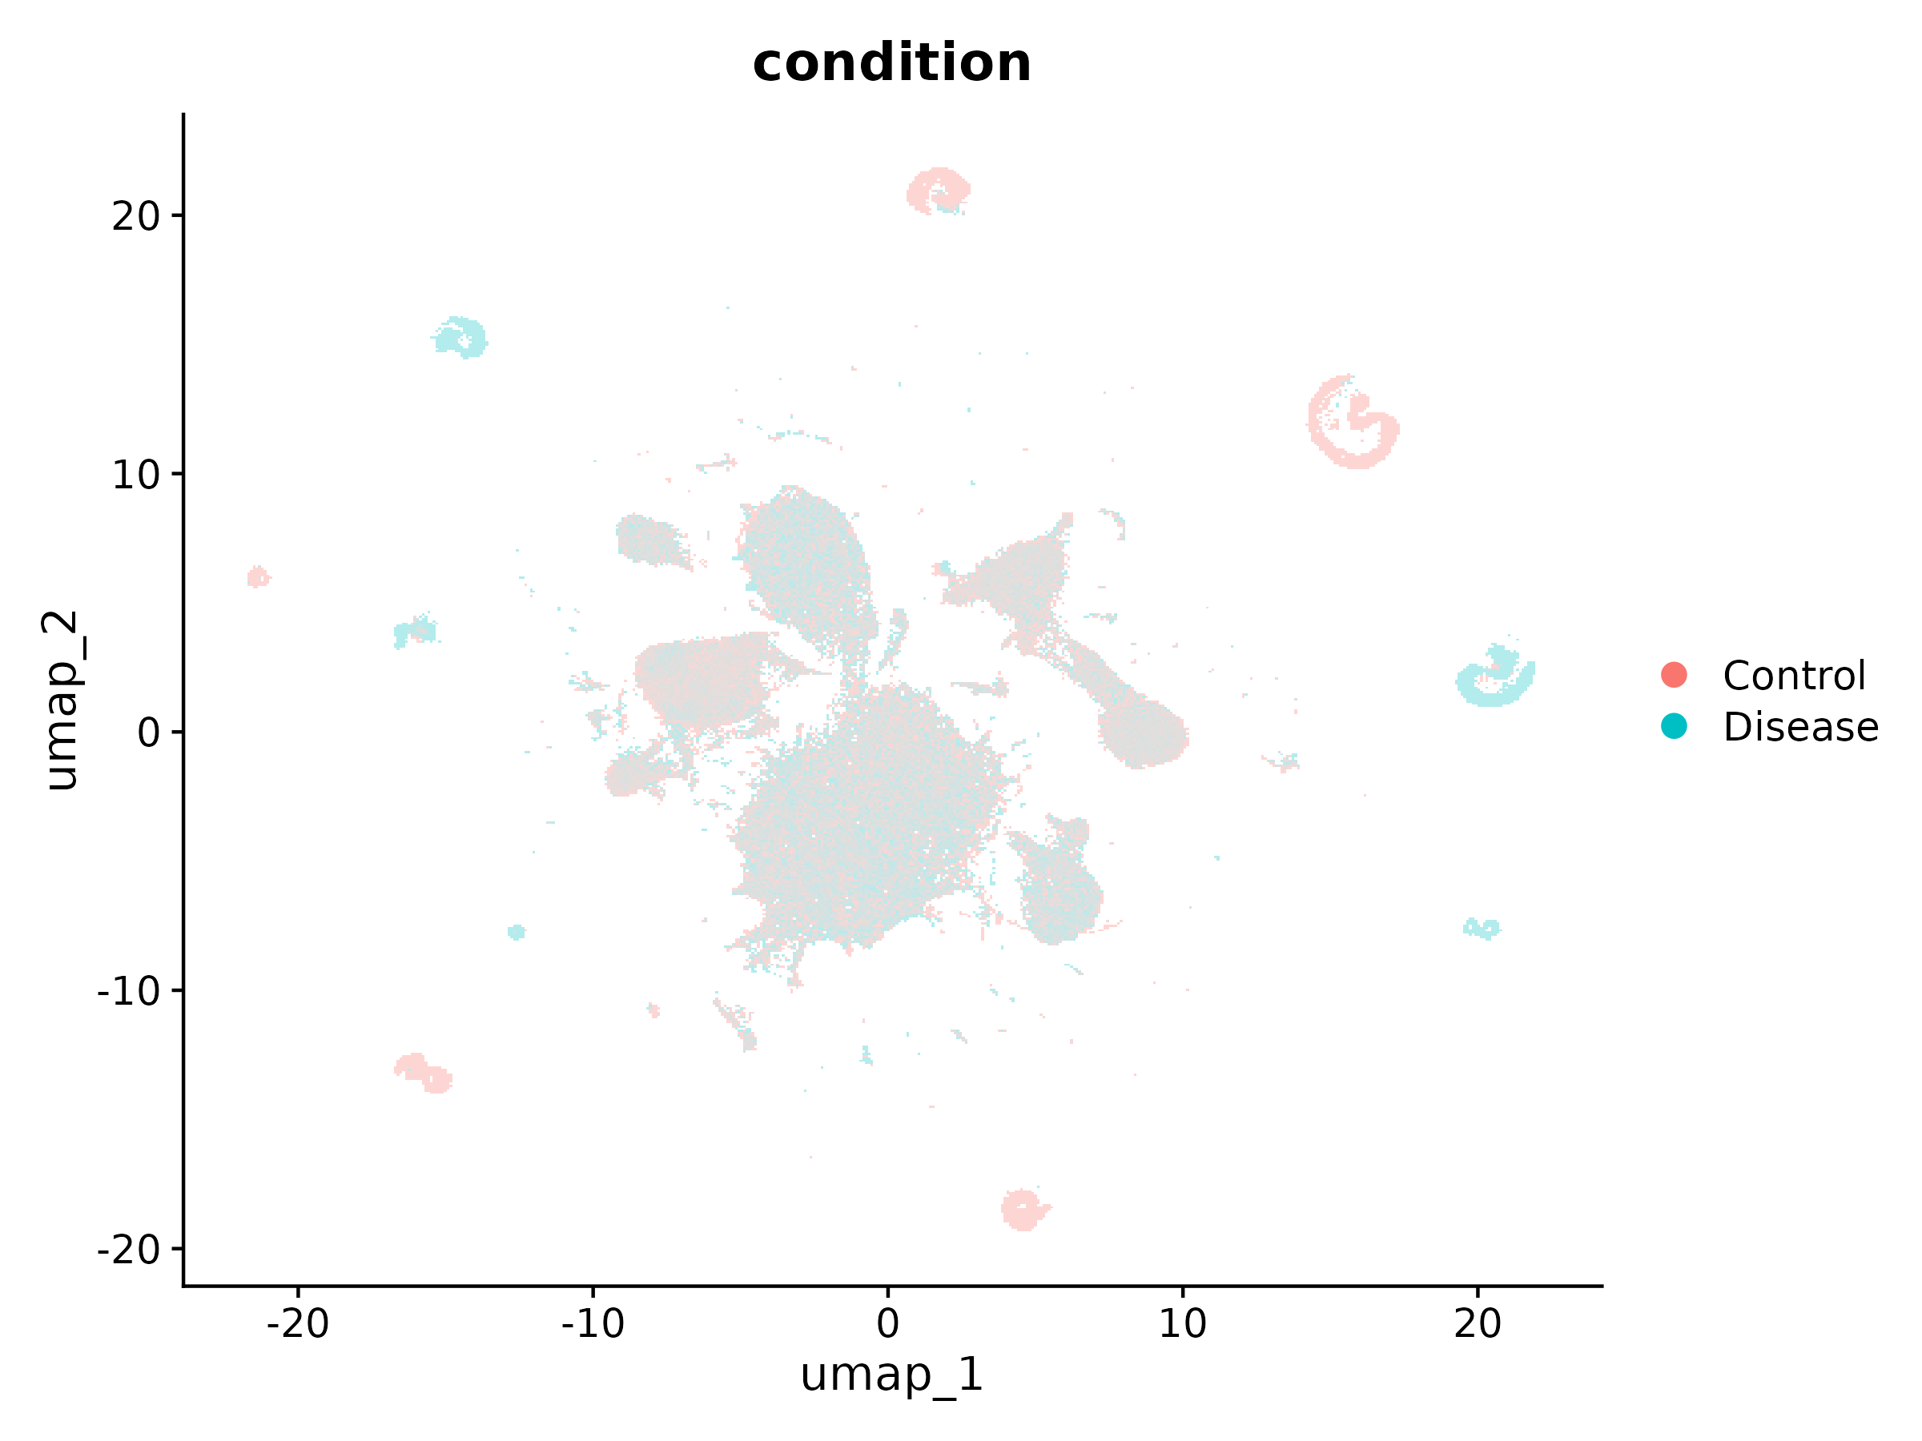
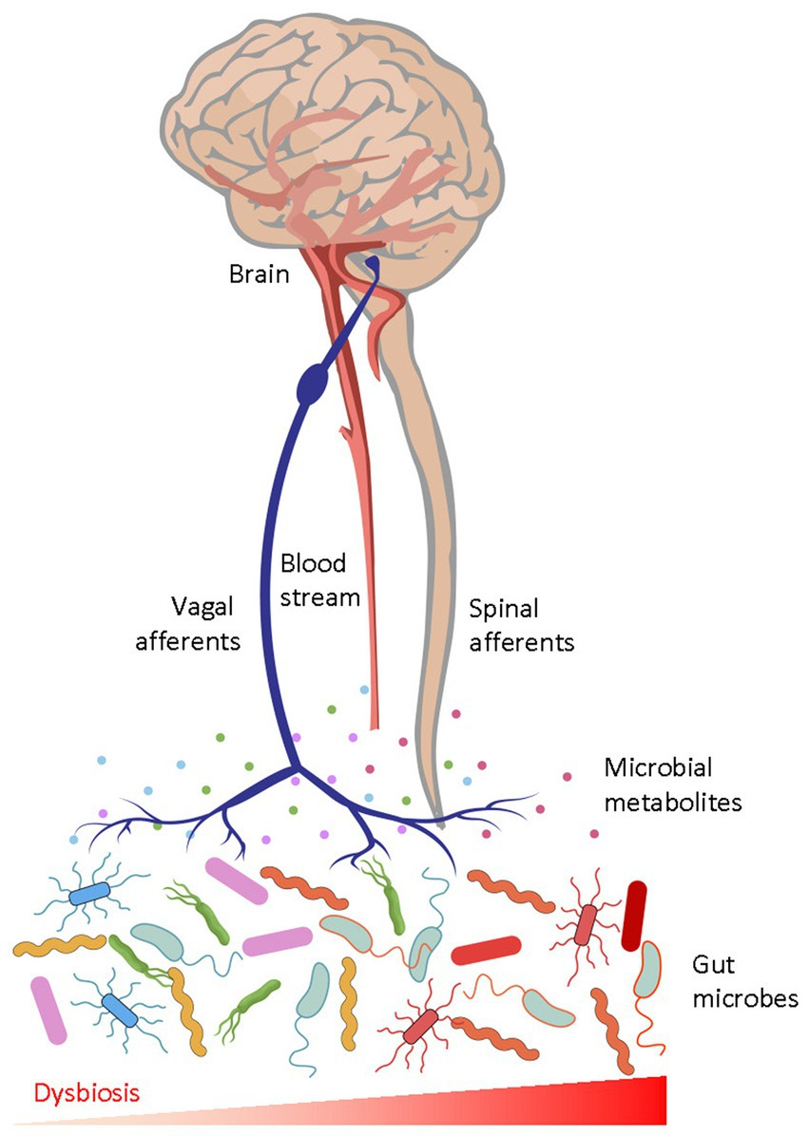
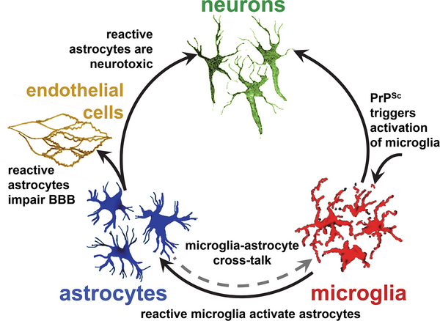
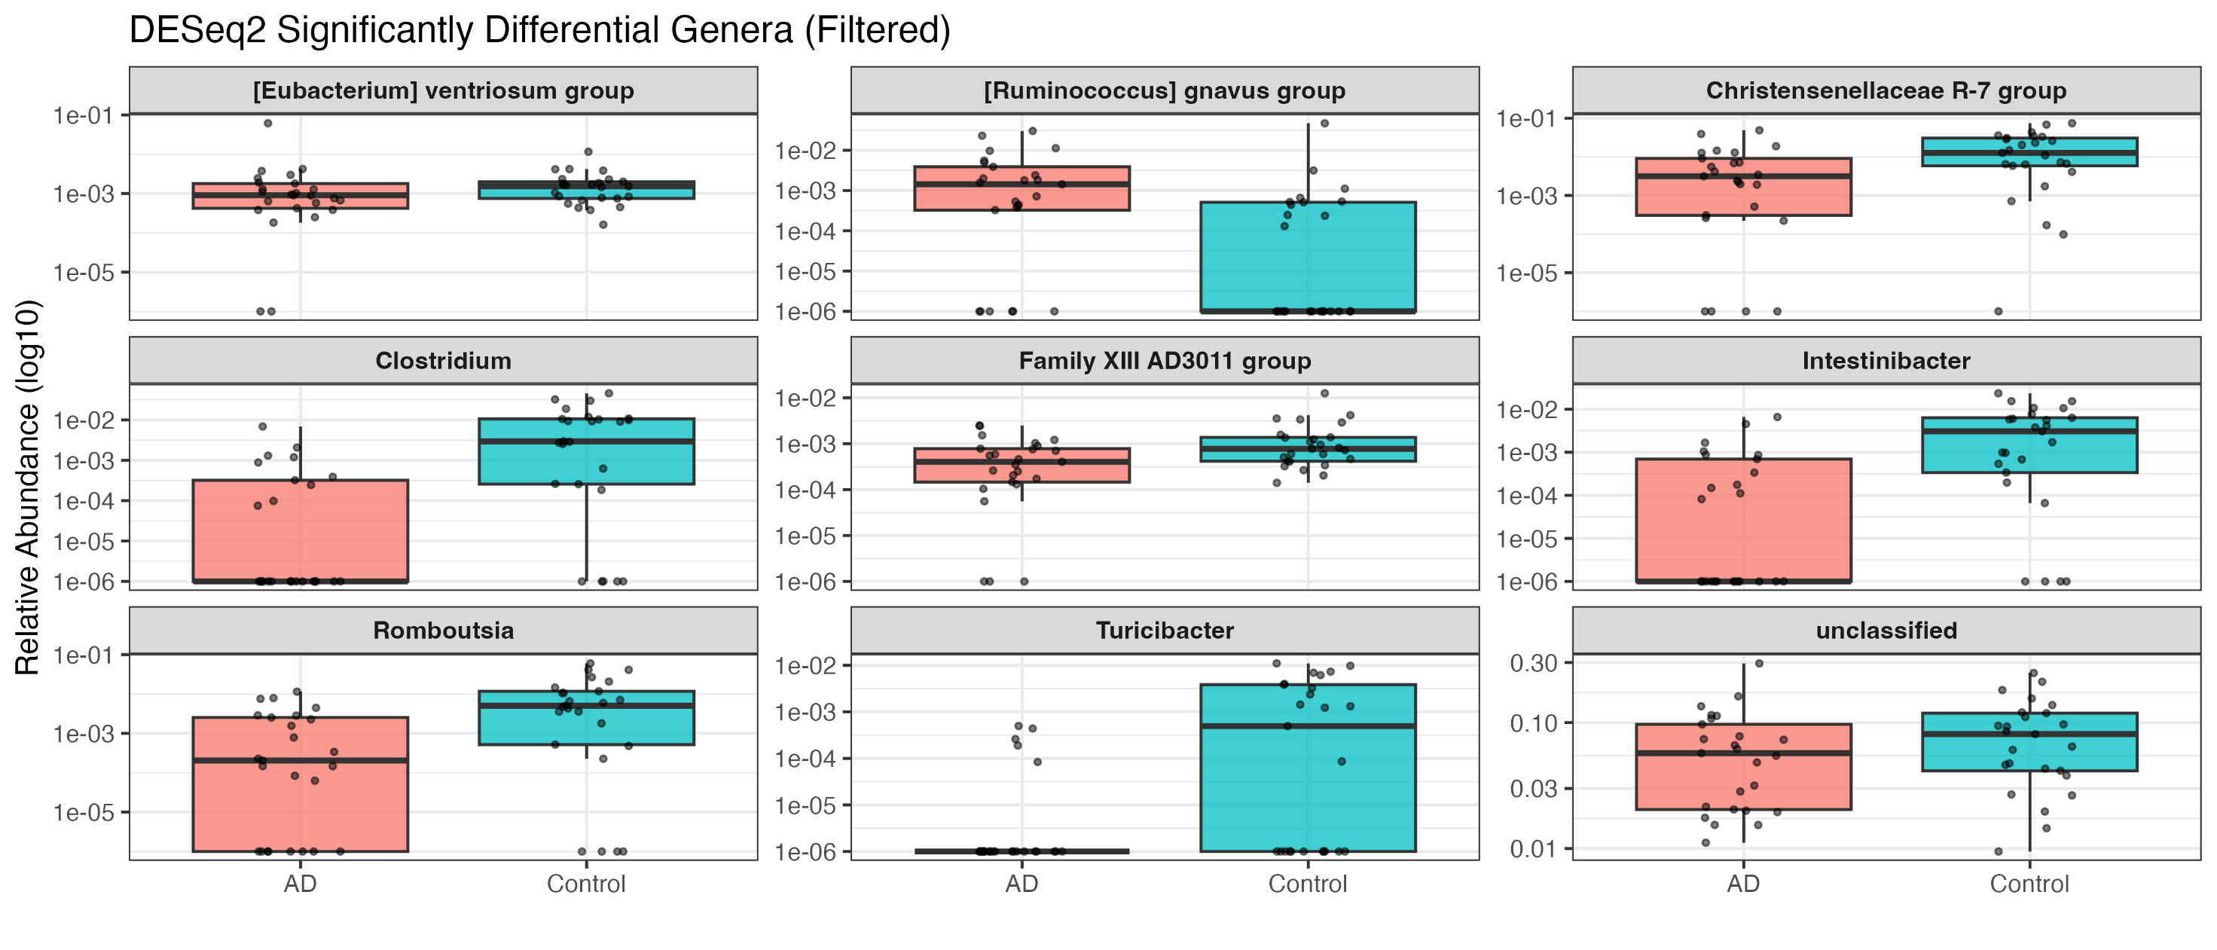

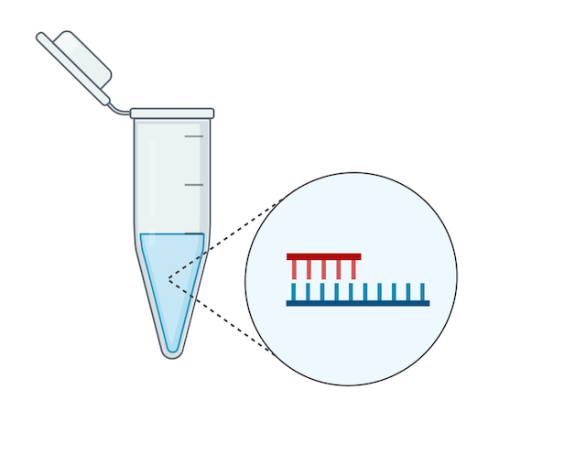
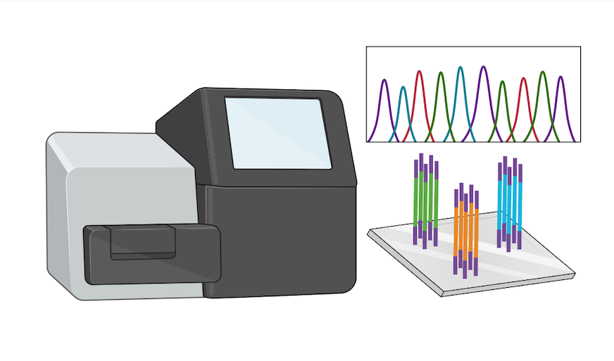
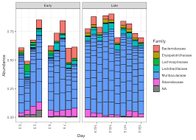
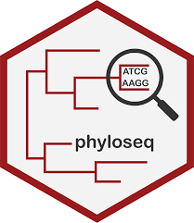
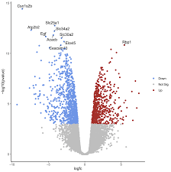
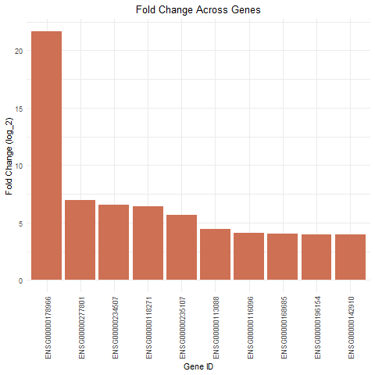
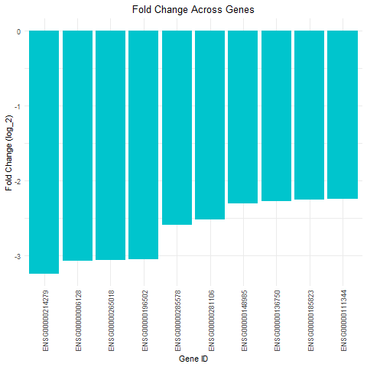
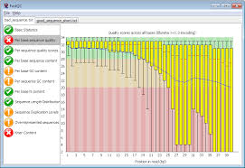
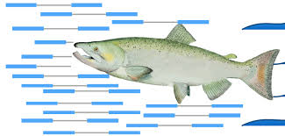

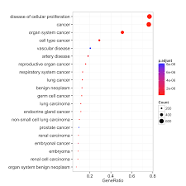

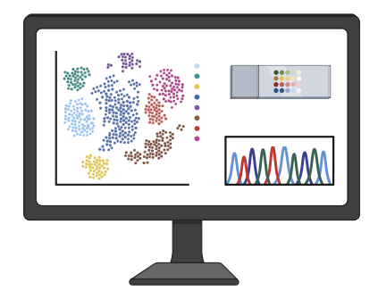
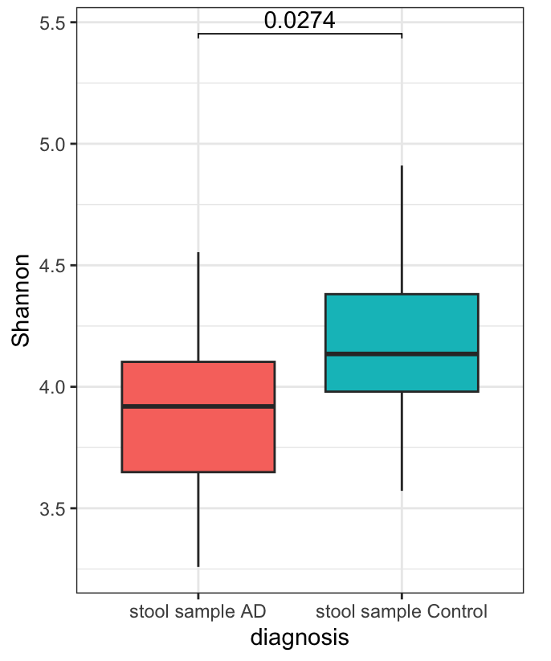
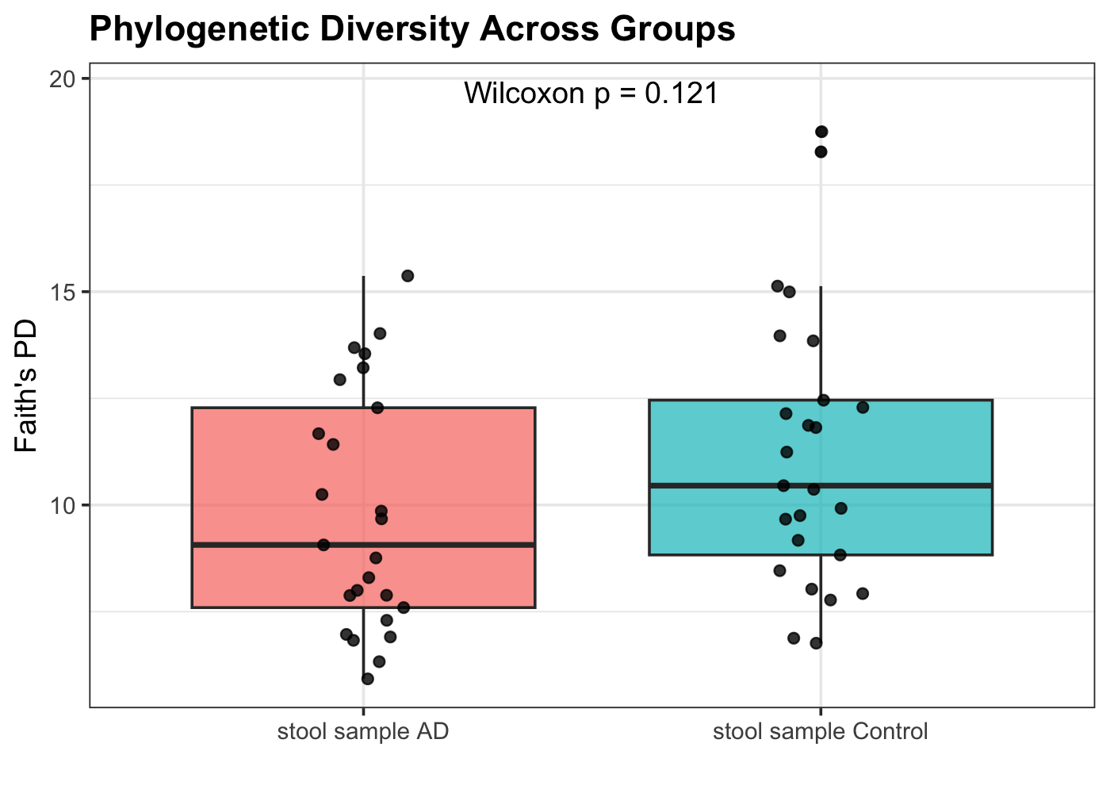
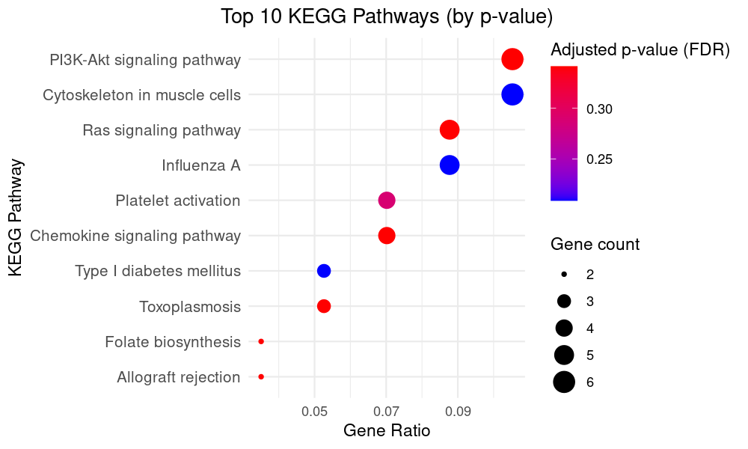
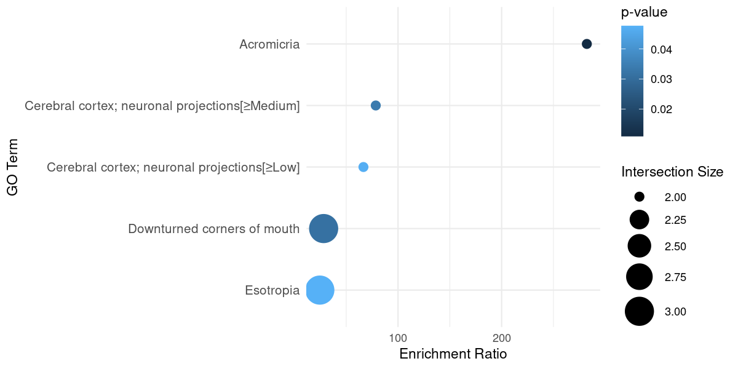
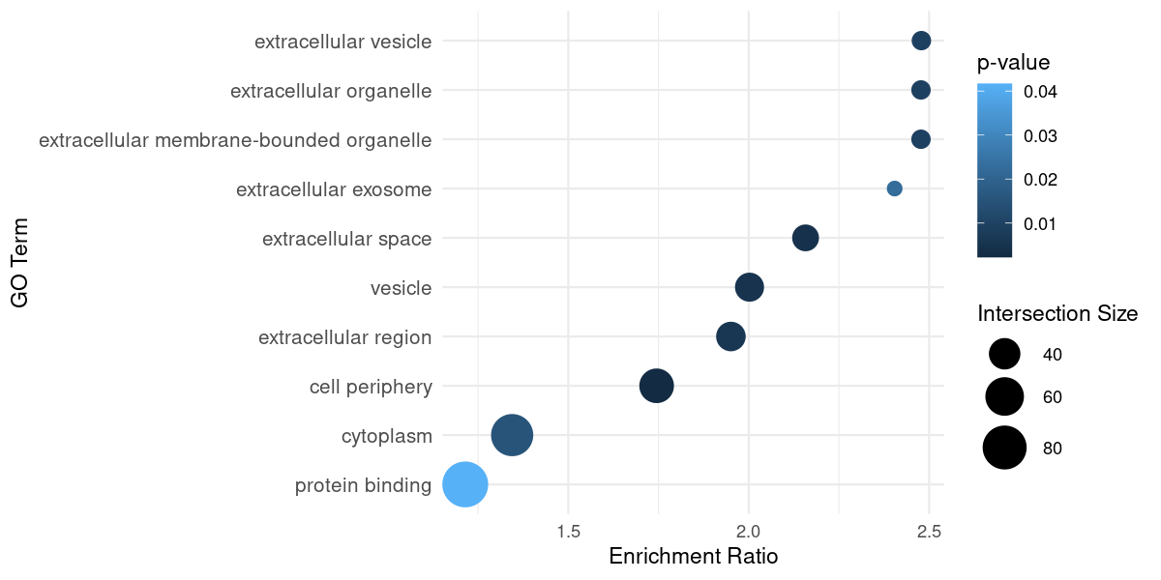
Think with your Gut: Linking Microbiome Phylogenetics to Brain Cell Regulation in Alzheimer's Disease
Mahathir Khan ^{[1,2]} , Sofia Kaplan ^{[2]}, Aman Mulla ^{[2]}, Kelechi Ejiofor ^{[2]}
^{[1]} Department of Mathematics at University of Rochester, Rochester NY. USA ; ^{[2]} Department of Biology at University of Rochester, Rochester NY. USA
Introduction
Results
Results
C.
D.
A.
Alzheimer’s Disease (AD) is the primary cause of dementia affecting the elderly, and more than six million Americans are estimated to suffer from AD, but there is currently no effective treatment (21). AD is characterized by disruption in neuronal function via accumulation of amyloid beta in plaques and phosphorylated tau protein in tau tangles (14). Increasing evidence links disruptions in the human gut microbiome to neurodegeneration, like in AD. A recent comprehensive study surveyed whole gut microbiota in humans with AD and found decreased microbial richness and reported a reduction in Firmicutes and Actinobacteria, and an increase in the phylum Bacteroidetes in AD brains (2). Increasing evidence supports that glial cells, including microglia and astrocytes, may play key roles in neuroinflammation in AD pathology (10). Single-cell transcriptomic analysis will allow for determination of cell-specific changes in gene expression that may reveal the role of glial cells in AD pathology. The objective of this project is to investigate how the gut microbiota phylogeny and brain cell-specific expression differ between AD and healthy patients. We hypothesize increased expression of neuroinflammatory genes including the NF-κB and MAPK signaling cascades (8) and NLRP3 inflammasome (22), in the brains of AD patients in glial cells. We also hypothesize phylum and genus-specific differences in microbiota in AD vs control.
A.
B.
A.
B.
Figure 1. (A) The gut-brain axis. The gut-brain axis is a complex, bidirectional network that links the brain and gut using the vagus nerve, the immune system, endocrine system and circulatory systems (B) Cellular cross-talk in AD. AD dysfunction results primarily from damages to neurons but also involves disruption in communication with glial cells that provide nutrition and protection to neurons, and endothelial cells that allow toxic substances to cross the blood brain barrier.
E.
Figure 4. UMAP visualization of single-cell analysis. (A) Cell-Type UMAP visualization of cell types for single-cell RNAseq data. (B) Condition UMAP visualization of condition type for single-cell RNAseq data from Ben Logsdon.
Summary
16s: Shannon Diversity Assessment indicated that AD had fewer genera present and/or less evenly distributed genera in comparison to control (p < 0.03). Faith’s PD indicated that there was no significant differences in relatedness between AD and control (p > 0.05) indicating overall richness may be unchanged, so Shannon’s Diversity Assessment most likely showed significance due to genera evenness rather than richness. According to β-diversity analysis (PCoA) showed two distinct clusters (21.5% variance between AD and control) indicating composition and relative abundance are altered. The volcano plot elaborates further by attributing the differential abundance across genera being due a decrease in AD genera. The boxplots show the specific genera that significantly increase or decrease as determined by DESeq2
Bulk RNA-seq: Major upregulated genes in AD are involved in protein binding and the extracellular matrix, which could be related to tau dysregulation given that tau is a key cytoskeletal protein involved in protein binding. Major downregulated genes include GTPases, which have been shown to be linked to mitochondrial dysfunction and decreased vesicular transport needed to regulate tau clearance in AD. These findings are supported by KEGG and GO pathways that found increased extracellular vesicles and dysfunction of cytoskeletal proteins like tau. The Ras pathway was also enriched which has been linked to amyloid-beta-mediated AD pathology.
Single-cell RNA-seq: Oligodendrocytes (associated with production of amyloid-β) and Excitatory Neurons (associated with tau accumulation) showed variety of gene profiles and form ring of smaller clusters around large central clusters possibly due to the presence of different excitatory neurotransmitters
Methods
Figure 2. Beta Diversity. (C) Beta diversity was assessed using PCoA (Principal Coordinate Analysis) to show Bray-Curtis dissimilarity represented through two-dimensional clustering patterns between AD and control samples. (D) Volcano plot of increased and decreased genera in AD. Volcano plots showing differential abundance across genera in AD compared to control with points representing direction of fold change (positive, negative, or neutral) based on placement left, right or on the vertical dotted line for all significantly different genera (represented by points above the horizontal line). (E) Significantly different genera in AD. Genera significantly decreased or increased in AD by relative abundance (log10) as determined by DESeq2.
A.
A.
B.
Data Collection
DNA extraction
16s Amplicon Sequencing
Taxonomical Analysis using DADA2
Creating phyloseq Objects for Visualization & Analysis
Differential Abundance Analysis
Limitations
B.
C.
The greatest limitation to this project was the use of multiple separate datasets. Analyses of 16s microbiome data was done independently and then compared to independently analyzed hippocampal bulk RNAseq data. Given that the data sources are independent and not subject matched, we are only able to make weak, cursory connections between the observations we made in 16s microbiota and brain activity.
Moreover, as with any gut microbiome study there are numerous confounding factors that need to be controlled. Our datasets accounted for age and sex; however, they did not filter for certain comorbidities like Cardiovascular disease.
Finally, our hippocampal data set did not establish baseline levels of cognition for control and AD patients. This would be a useful benchmark to have for future cases as to not mistake natural variation for AD pathology.
RNA-seq FASTQ Processing
Alignment (Salmon)
Differential Gene Expression
Gene Ontology Analysis
KEGG Pathway Analysis
UMAP Cell Clustering
Future Directions
Figure 1. Methods & Pipeline for Analysis. (A) 16s Data Methods. Showing the 16S pipeline from sample collection and DNA extraction to amplicon sequencing, taxonomic assignment, phyloseq object creation, and differential abundance analysis. (B) RNA seq Data Methods. Showing the bulk RNA-seq pipeline, beginning with FASTQ processing and quality control, followed by Salmon quasi-alignment, differential gene expression analysis with DESeq2, and downstream pathway, GO and KEGG. (C) UMAP clustering. Showing the UMAP-based dimensionality reduction used to visualize single-cell RNA-seq data, allowing identification of distinct cell populations and condition-specific clustering patterns.
Results
To strengthen the preliminary observations proposed in this study between gut microbiota composition and hippocampal RNA-seq profiles, future studies must prioritize collecting gut and brain samples from the same individuals, rather than relying on multiple separate data sets. Future work should also more rigorously control for potential confounding variables, including dietary habits, medication use, metabolic conditions such as diabetes, and other comorbidities known to influence both gut microbiome diversity and cognitive outcomes.
It could also be interesting to investigate fecal metabolites to identify mechanistic changes by which the activity in the gut microbiome effects the brain and AD pathology.
A.
B.
C.
D.
References
Maffioli, E., Murtas, G., Rabattoni, V., Badone, B., Tripodi, F., Iannuzzi, F., Licastro, D., Nonnis, S., Rinaldi, A. M., Motta, Z., Sacchi, S., Canu, N., Tedeschi, G., Coccetti, P., & Pollegioni, L. (2022).
Insulin and serine metabolism as sex-specific hallmarks of Alzheimer`s disease in the human hippocampus.
Cell Reports, 40(10), 111271.
Li, J., Feng, G., Huang, Z., Fang, Y., Li, Y., Xu, W., & Guo, G. (2024). Aedes aegypti gut microbiome modulates arbovirus infectivity through antiviral immune pathways. PLOS Pathogens, 20(3), e1012286. https://doi.org/10.1371/journal.ppat.1012286.g001
Ben.Logsdon. (2015). AMP AD Target Discovery Data Portal [Dataset]. Synapse. https://doi.org/10.7303/SYN2580853
GENCODE. (n.d.). Human genome annotation — Release 49. from https://www.gencodegenes.org/human/
Tan, H.-E. (2023). The microbiota–gut–brain axis in stress and depression. Frontiers in Neuroscience, 17. https://doi.org/10.3389/fnins.2023.1151478
Vogt, N. M., Kerby, R. L., Dill-McFarland, K. A. et al. (2017).
Gut microbiome alterations in Alzheimer’s disease.
Scientific Reports, 7, 13537.
E.
Figure 3. Differential expressed genes for Maffioli et al bulk RNA-seq data. (A) Upregulated genes in AD. Top ten upregulated genes between AD and control patients. Fold change values are shown on a log₂ scale. (B) Downregulated genes in AD. Top ten downregulated genes between AD and control patients. Fold change values are shown on a log₂ scale. (C) KEGG Pathways. Top ten KEGG Pathways by p-value. (D) Downregulated GO terms. Top ten Downregulated GO terms in AD. (E) Upregulated GO terms. Top ten Upregulated GO terms in AD.
For full list of references used in this project refer to: https://github.com/Mahathir-Khan/Bio257_2025_Project/blob/main/Papers/References_Master_List.md
Images were created using Biorender.com
Figure 2. Diversity metrics for Vogt et al. 16S data. (A) Shannon’s Alpha Diversity. Shannon Diversity Index was calculated on ASVs for AD and control samples to evaluate differences in richness and evenness between AD and control samples. (B) Faith’s PD Alpha Diversity. Comparison of average phylogenetic diversity between stool samples from AD and control patients as a representation of evolution within populations based on relatedness between genera using Wilcoxon Rank Sum Test.
Acknowledgements
We thank Dr. Amanda Larracuente and the BIO 257 TAs for her support and guidance throughout this project.
We also thank Logsdon, Vogt, and Maffioli for making their data publicly accessible, which enabled our analyses.

